Slide 1
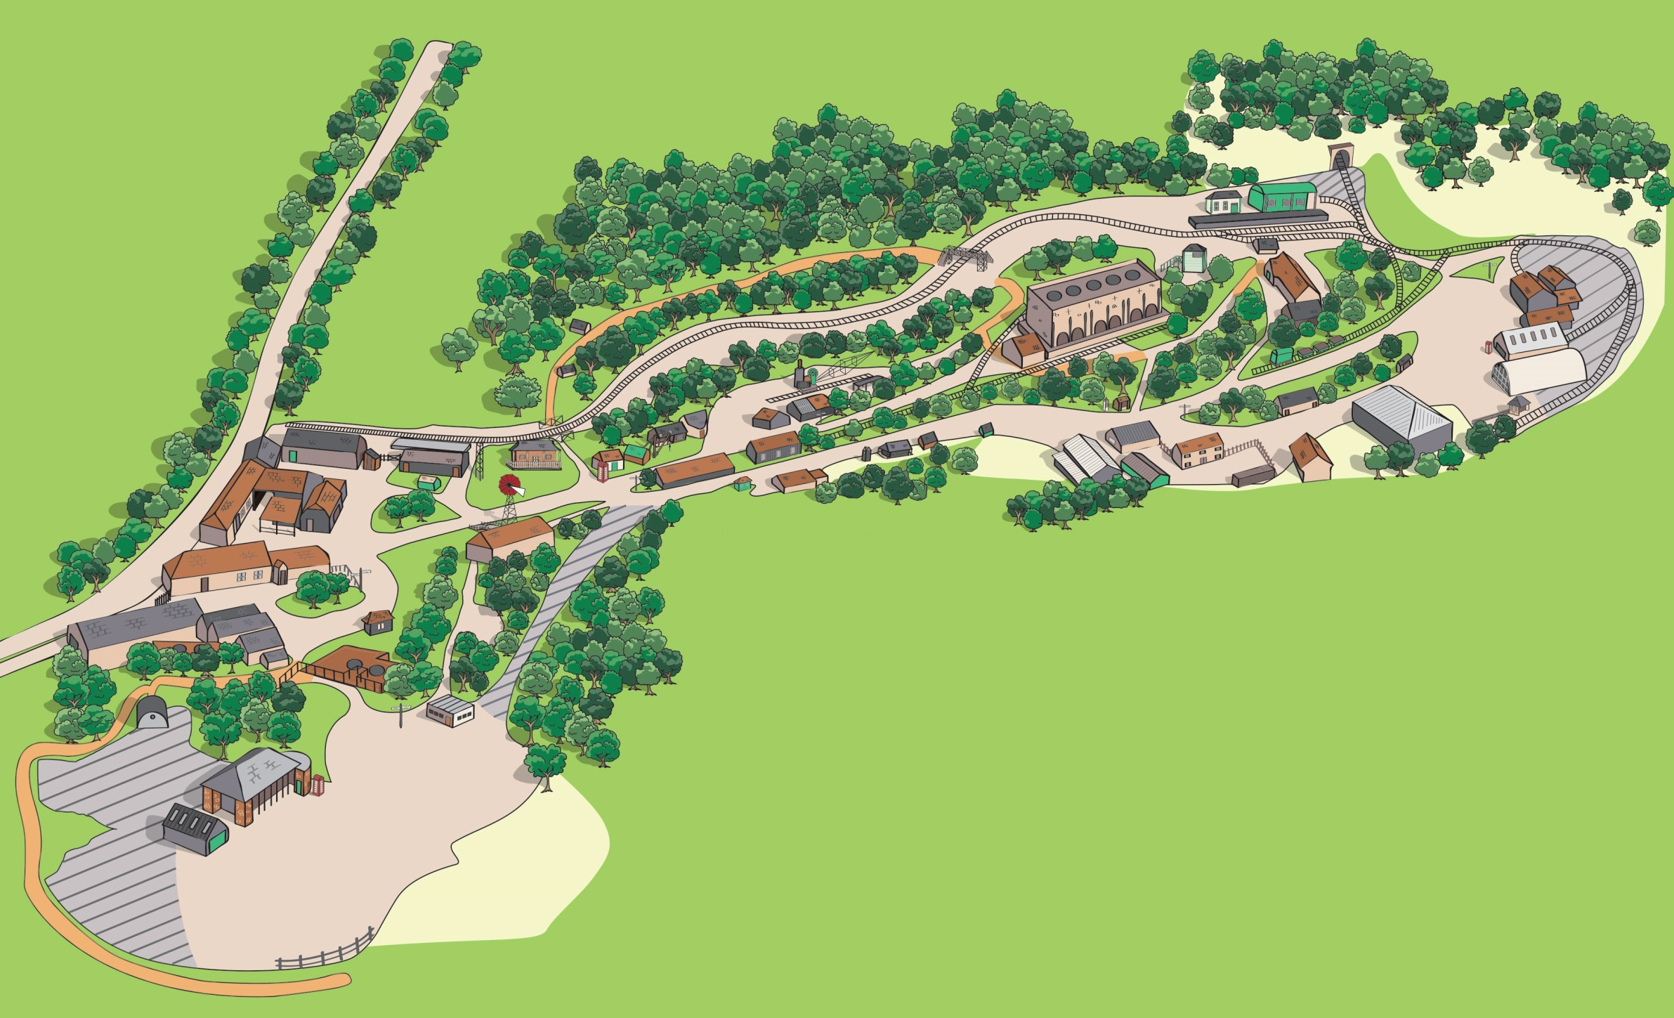
24-30
19-23
14-18
13
31
12
11
4
5-10
ENTRANCE
32
Amberley Sculpture Trail
25th July – 31st October
3
36-37
33
1
2
Welcome to Amberley Museum’s Sculpture Trail. This is our first sculpture exhibition, which we officially opened a couple weeks before the COVID-19 closure in March. We hope that you enjoy the varied exhibits set against the backdrop of an industrial landscape shaped by chalk pits and lime kilns.
We would like to thank all the sculptors for supporting us in this venture and allowing us to exhibit their work and hope that this will become an annual fixture in the Amberley calendar.
To purchase any of the sculptures please enquire at the Museum entrance or contact:
office@amberleymuseum.co.uk
www.amberleymuseum.co.uk
35
34

Slide 2
Amberley Sculpture Trail – Sculpture Information
Sculptor | Name of work | Price (£) | Material | Location Number | Location
Simon Probyn | ‘Pebbles’ | 2750 | Metalwork | 1 | Grass opposite Office
Alex Smith | ‘Feel’ | 4200 | Steel | 2 | Grass next to Dover Cottage Pump House
Alex Smith | ‘Forever’ | 2200 | Steel | 3 | Grass near Dando wind pump
Lester Korzilius | ‘Shift’ | 125 | Fibreglass | 4 | Near Bus Stop
Ian Marlow | ‘Large leaf’ | 1700 | Stainless steel | 5 | Village Green
Ian Marlow | ‘White Flower’ | 2100 | Stainless steel | 6 | Village Green
Ian Marlow | ‘Seeds’ | 2000 | Stainless steel | 7 | Village Green
Ian Marlow | ‘Together’ | 1100 | Stainless steel | 8 | Village Green
Ian Marlow | ‘Two fish’ | 1100 | Stainless steel | 9 | Village Green
Ian Marlow | ‘Blue Cluster’ | 2000 | Stainless steel | 10 | Village Green
Lester Korzilius | ‘Vortex’ | 500 | Oxide pigment, wood, steel | 11 | Tools & Trades HS, Greenwood Village
Cliff Palmer | ‘Jabberwock’ | 3125 | Stone | 12 | Opposite Gin Building
Michael Joseph | ‘Serene’ | 2250 | Metal tubing | 13 | Outside Life and Lime exhibition
Paul Harvey | ‘Red Kite’ | 1800 | Mixed metal resin | 14 | Path opposite De Witt kilns
Paul Harvey | ‘Raven’ | 1150 | Mixed metal resin | 15 | Path opposite De Witt kilns
Paul Harvey | ‘Tawny Owl’ | 725 | Mixed metal resin | 16 | Path opposite De Witt kilns
Paul Harvey | ‘Little Owl’ | 335 | Mixed metal resin | 17 | Path opposite De Witt kilns
Paul Harvey | ‘Kestrel’ | 525 | Mixed metal resin | 18 | Path opposite De Witt kilns
Cherie Lubbock | ‘Swing Dance’ | 930 | Steel, rubber, plaster, orange paint | 19 | Brick Drying Shed
Cherie Lubbock | ‘Song to the Sirens’ | 930 | Steel, pink paint | 20 | Brick Drying Shed
Cherie Lubbock | ‘Jealousy’ | 930 | Steel, red and pink paint | 21 | Brick Drying Shed
Cherie Lubbock | ‘Divine Guardian’ | 420 | Wood, plaster, paper, pulp, plastic, plasticine, jesmonite, white paint | 22 | Brick Drying Shed
Cherie Lubbock | ‘Tables of Delight’ | 310 | Wood, paper pulp, plaster, silicon, latex, plasticine | 23 | Brick Drying Shed
Lester Korzilius | ‘Spectra’ | 200 | Acrylic, MDF | 24 | Hove Ticket Office
Lester Korzilius | ‘Alternation’ | 70 | Acrylic paint, jesmonite | 25 | Hove Ticket Office
Lester Korzilius | ‘8 Mirrors/2 oranges’ | 70 | Steel, mirrors, oranges | 26 | Hove Ticket Office
Lester Korzilius | ‘Contingent’ | 70 | Steel, mirrors, steel wool | 27 | Hove Ticket Office
Lester Korzilius | ‘Before and after’ | 70 | Mirrors, wax, MDF | 28 | Hove Ticket Office
Lester Korzilius | ‘Reflections of the mind’ | 70 | Mirrors, steel, plaster, lemons | 29 | Hove Ticket Office
Lester Korzilius | ‘Pegasus’ | 70 | Blue acrylic paint, paper pulp, steel | 30 | Hove Ticket Office
Emma Nicole Straw | ‘Woven Watercolour’ | 5600 | Tapestry | 32 | Limeburners Café
Sarah Blunden & Ben Fraser | ‘Pea’ | 8750 | Wrought Iron | 33 | Path leading to Playground
Simon Probyn | ‘Cypress Tree | 2250 | Metalwork | 34 | No.2 Kilns upper level
Simon Probyn | ‘Flame’ | 2375 | Metalwork | 35 | Grass at top of steps, above No1 Kilns
Cherie Lubbock | ‘High Priest to the moon’ | 180 | Plastic, wood, string, silk, plasticine | 36 | Shop
Cherie Lubbock | ‘Raised to lift the roof’ | 180 | Foam, wood, plasticine, wire | 37 | Shop

